Slide 1
Inside The Co-Occurrence Recommendation Engine
Brett Lindsley
https://github.com/brett-lindsley

Slide 2
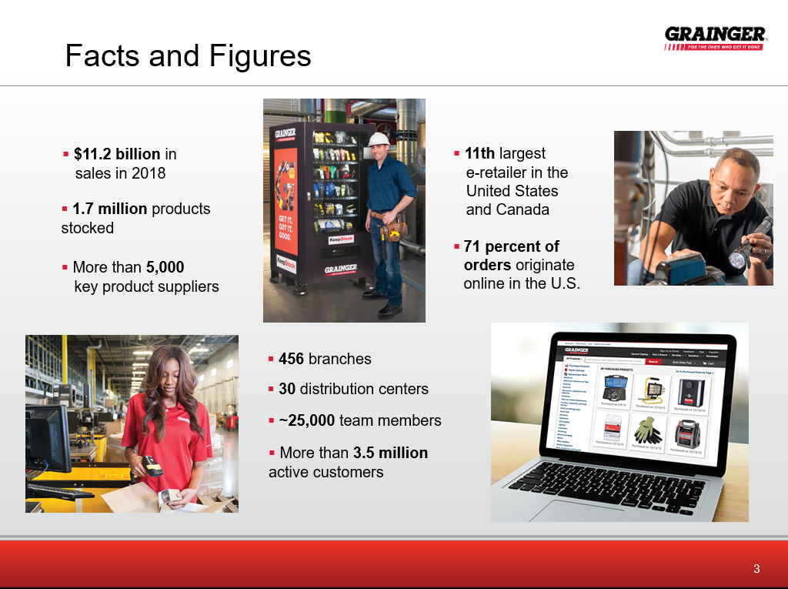

Slide 3


Slide 4
What is “Recommendation”?
Many different definitions, systems, etc.
We will use
Interactions between an “actor” and an “item”.
Suggest additional interactions that have not yet been observed.
Something the actor may want to do, but does not know it.
Realistic difficulties: Many users, many items, but sparse data.
A recommender needs to fill in the sparse matrix, but in a relevant way.

Slide 5









Types Of Recommenders
Read
by user
Buy and Rate
Similar
Buy and Rate
Recommend
Similar
Articles
Recommend
Buy
Content-Based
Filtering
User Collaborative Filtering
Recommend
Item-Based Filtering
Buy

Slide 6
What Data Accurately Reflects Human Preferences?
Unfortunately, human-based ratings does not work well.
Use people’s behavior.
Watching what people do (interactions) is far more powerful than having them record what they say they like.

Slide 7
Modeling User Interactions

Slide 8

Raw Data – Item Interactions
Interactions
Example data set:
4 users.
8 items.
Raw Interactions
user: 0, interaction: 7
user: 0, interaction: 3
user: 3, interaction: 3
user: 0, interaction: 1
user: 0, interaction: 4
user: 3, interaction: 2
user: 2, interaction: 3
user: 3, interaction: 0
user: 1, interaction: 2
user: 2, interaction: 2
user: 1, interaction: 5
user: 2, interaction: 4
user: 1, interaction: 7
user: 2, interaction: 1
user: 3, interaction: 6
Item - 1
Item - 2
Item - 3
User 0
Item - 4
Item - 5
Item - 6
Item - 7
Item - 8
We can see item 7 was interacted with by both users 0 and 1. We can see the set of interactions by a particular user comprise a relationship between those items.
User 1

Slide 9

“A” – The Item History Matrix
Compress the raw interaction list vertically.
Items
Users
User 0 interacted with items 1, 3, 4, 7.
We only use a binary flag (0/1) even though the user may interact with the same item multiple times.

Slide 10

What Can We Do With The A Matrix?
Consider a current interaction vector h:
A user has interacted with item 4 once.
Users who have interaction “h” (the vector of items we are currently interacting with):
A
Translates items to users.
A^{T}
Translates users to items.
Ah
The users currently interacting with the items.
A^{T}(Ah)
User-centric recommendations – given the users from Ah, what do they recommend.
(A^{T}A)h
Item-centric recommendations – given the co-occurrences of interactions, what do they recommend.

Slide 11

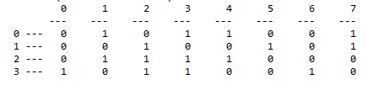
Current User Interactions - Ah
A
h
Ah
Interaction
User
*
=
Raw Interactions
user: 0, interaction: 7
user: 0, interaction: 3
user: 3, interaction: 3
user: 0, interaction: 1
user: 0, interaction: 4
user: 3, interaction: 2
user: 2, interaction: 3
user: 3, interaction: 0
user: 1, interaction: 2
user: 2, interaction: 2
user: 1, interaction: 5
user: 2, interaction: 4
user: 1, interaction: 7
user: 2, interaction: 1
user: 3, interaction: 6
An arbitrary user has interacted with item 4 once.
Users 0 and 2 have interacted with item 4.

Slide 12
User-Centric Recommendations
A^{T}(Ah)

Slide 13
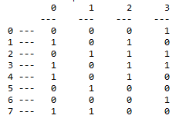

User Centric Recommendation A^{T}(Ah)
*
=
User 0 interactions -> 1, 3, 4, 7
User 2 interactions -> 1, 2, 3, 4
A^{T}
Ah
Raw Interactions
user: 0, interaction: 7
user: 0, interaction: 3
user: 3, interaction: 3
user: 0, interaction: 1
user: 0, interaction: 4
user: 3, interaction: 2
user: 2, interaction: 3
user: 3, interaction: 0
user: 1, interaction: 2
user: 2, interaction: 2
user: 1, interaction: 5
user: 2, interaction: 4
user: 1, interaction: 7
user: 2, interaction: 1
user: 3, interaction: 6
Item
Recommendation Weight
This is interesting, a current interaction with item 4 (the “h”) shows us that two users (0,2) have interacted with item 4 (Ah) once, thus, the combined interactions/recommendations of both users is items (1, 2, 3, 4, 7) with various weights.

Slide 14
User vs Item Recommender Performance
A – [U x I] size matrix
A^{T} – [I x U] size matrix
h – [I x 1] size matrix
User Centric
Item Centric
A^{T}(Ah)
[I x U] ([U x I] [I x 1])
[I x U] [U x 1]
[I x 1]
(A^{T}A)h
([I x U] [U x I]) [I x 1]
[I x I][I x 1]
[I x 1]
The real-time computation with the user vector (multiply in parenthesis) must be done first.
No way to pre-compute.
Slower response time.
Precompute the part in parenthesis.
May be done off-line (e.g. overnight).
Only the recommendation for the smaller user vector needs to be done in real-time.

Slide 15
What Is Co-Occurrence?
A data analysis technique – predictive analytics
“Sessionization” – grouping data into sessions. i.e. Documents, blog posts, time frames, login to logout, etc.
Consider the information in a session to have “occurred together”.
Determine importance of information.
What can we do with it
Predict the likelihood of information in other sessions (i.e. a “recommender”).
Predictive failure – Predict a high likelihood of equipment failure before it happens.
Social networking – Predict relationships between actors in a session.

Slide 16
Co-Occurrence Overview By Example
Example key idea: What would the data show if people and companies had nothing to do with each other?

Slide 17
Text Processing With Co-Occurrence
Companies
Text Documents
(Sessionization)
 | Apple | Facebook | Tesla
Elon Musk | 10 | 15 | 300
Mark Zuckerberg | 500 | 10000 | 500
Tim Cook | 200 | 30 | 10
P(Elon Musk) = 325 / 11,540
People
Count of how many times a document contains both “Telsa” and “Elon Musk”.
If we normalize by the total count (11,540), we have
P(Tesla, Elon Musk)
Co-Occurrence Matrix
P(Tesla) = 810 / 11,540
Normalized counts are just “popularity”; how do we find “importance”?
Need to compare to P(Tesla)P(Elon Musk) – The expected probability if they were independent.
Expected Count
= P(Tesla) P(Elon Musk) * Total
= (810 / 11,540) * (325 / 11,540) * 11,540
= (810 * 325) / 11,540
= 22.8
Hmm… The observed co-occurrence count is 300, the expected count is 22.8. We need to determine if this relationship is “important”. More on this later… ☺
http://www.andrew.cmu.edu/user/georgech/94-775/Lectures/UDA%20Lecture%2002%20-%20Basic%20Text%20Analysis%20Wrap-up,%20Co-occurrence%20Analysis.pdf

Slide 18
What About Telsa and Mark Z?
For now just ignore the total normalization.
Joint probability = P(Tesla, MarkZ) = 500.
Independent probabilities
P(Tesla) = 300 + 500 + 10 = 810 (column sum).
P(MarkZ) = 500 + 10,000 + 500 = 11,000 (row sum).
Expected count if independent = (810 * 11,000) / 11,540 = 772.1.
Ratios
Tesla and Elon Musk = 300/22.8 = 13.1.
Tesla and Mark Z = 500 / 772.1 = 0.65.
The ratio (or log of it) is typically called the Pointwise Mutual Information. If PMI == 1 (or log(PMI) == 0), they are independent. Thus, even though the count of (Telsa,MarkZ) is greater than the count of (Tesla,ElonM), this is just a coincidence.
Strong shared information between Tesla and Elon Musk.

Slide 19
Item-Centric Recommendations Using Co-Occurrence
(A^{T}A)h

Slide 20
Co-Occurrence Recommendation
New recommendations are based on similar past behaviors (not similar users).
Easy to understand. Java simulation is 10 pages.
Easy to implement. Can be implemented on a microcontroller.
Extensible
Efficient.
Excellent results compared to complex systems.

Slide 21
Co-Occurrence Matrix- What is it?
A simple way to represent events that occur together.
Indicates for each item pair, how many users interacted with it.
Steps
Raw data.
History matrix (A).
Co-occurrence matrix (C).

Slide 22

(A^{T}A) – The Co-Occurrence Matrix
C = A^{T}A
*
A^{T}
A

Slide 23
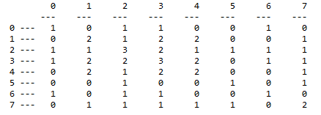
What Does C Tell Us?
Raw Interactions
user: 0, interaction: 7
user: 0, interaction: 3
user: 3, interaction: 3
user: 0, interaction: 1
user: 0, interaction: 4
user: 3, interaction: 2
user: 2, interaction: 3
user: 3, interaction: 0
user: 1, interaction: 2
user: 2, interaction: 2
user: 1, interaction: 5
user: 2, interaction: 4
user: 1, interaction: 7
user: 2, interaction: 1
user: 3, interaction: 6
There were 2 users that had interactions with both (3, 4).

Slide 24
Two Types of Recommenders Using Co-Occurrence
Current Interaction Recommender
Recommends based on current interactions.
Typically the current product basket.
Anomalous Relationship Recommender
Recommends based on interesting associations to a specific product returned in a search result.
Typically a current product view, could be associations to all products in a basket, etc.

Slide 25
Co-Occurrence Recommender Systems
Current Interaction Recommender
Search
Engine
Product
Request
Product Request
(current interaction)
Item
Metadata
Web
Tier
Product
Information
Product Information,
Recommendations
Recommendation
Request
User
Interaction
Batch Create
Co-occurrence
Generate Item Recommendations
Item recommendations
Anomalous Relationship Recommender
Search
Engine
Product
Request
Product Request
Item
Metadata
Web
Tier
Product
Information,
Recommendations
Batch Create
Co-occurrence
Generate “Importance”
Anomaly Indicators
Product Information,
Recommendations
User
Interaction
Add recommended items
to products.

Slide 26
Current Interaction Recommender
(A^{T}A)h
Search
Engine
Product
Request
Product Request
Item
Metadata
Web
Tier
Product
Information
Product Information,
Recommendations
Recommendation
Request
User
Interaction
Batch Create
Co-Occurrence
Generate Item Recommendations
Item recommendations
Note:
The returned product information and returned recommendations are independent.
The advantage is the co-occurrence matrix can be pre-computed for efficiency.

Slide 27

Making A Recommendation
*
=
Co-occurrence matrix C
Item interaction
Matrix
Note: Zero the diagonal before multiplying to avoid recommending the input.
Item
Items 1 and 3 are the highest recommendation, items 2 and 7 are the next highest.
Recommendation
Weight

Slide 28
Anomalous Relationships Recommender
(A^{T}A) -> Anomaly
Search
Engine
Product
Request
Product Request
Item
Metadata
Web
Tier
Product
Information,
Recommendations
Product Information,
Recommendations
User
Interaction
Batch Create
Co-Occurrence
Generate Importance Indicators
Add recommended items
to products.
Note:
The returned recommendations are part of the search results.
All recommendations are pre-computed.

Slide 29
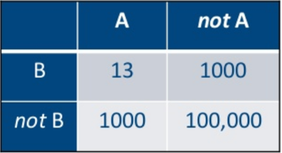
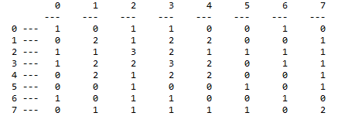

Computing Anomalous Relationships
E{}
History Matrix
Expectation Matrix
Contingency Matrix
G-Test Score
Co-Occurrence Matrix
Important Anomalous
Co-Occurrence Pairs
(0,6)
(1,2)
(2,3)
(2,4)
(2,7)
(3,7)
Selection of Most Important
Score threshold.
N highest.
Grouping/clustering.

Slide 30
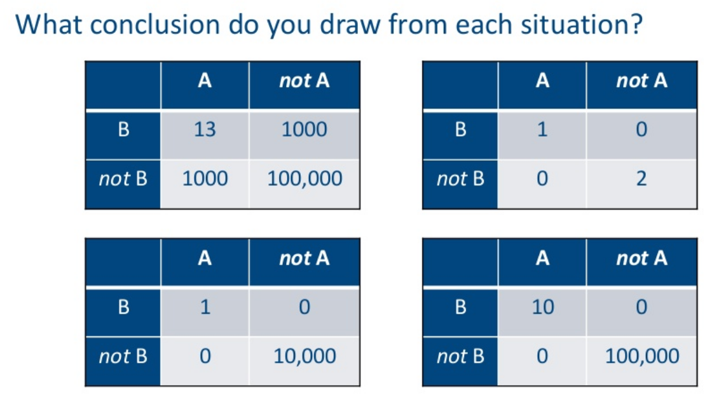
Analyzing A Specific Cooccurrence Can You Spot the Anomaly?
A and B are arbitrary pairs in the co-occurrence matrix.
i.e. “Let’s examine the relationship between items
A = 0 and B = 2”.
Four hypothetical situations…
https://www.slideshare.net/SessionsEvents/ted-dunning-chief-application-architect-mapr-at-mlconf-atl-91815

Slide 31
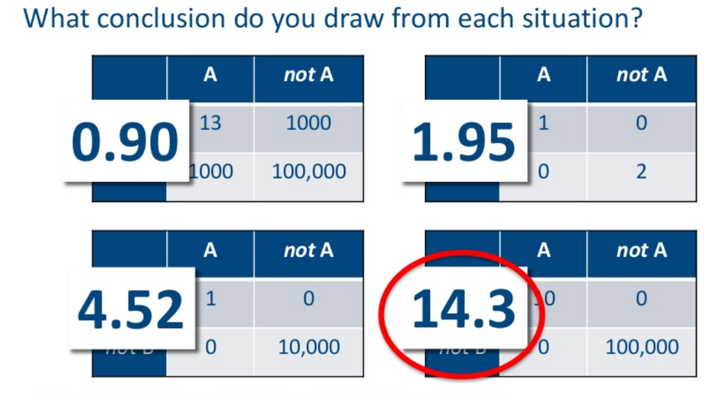
G-Test Score (aka Log Likelihood Ratio Score)
The G score is interpreted similar to a standard deviation.
https://www.slideshare.net/SessionsEvents/ted-dunning-chief-application-architect-mapr-at-mlconf-atl-91815

Slide 32
1 - Compute Contingency Matrix
The contingency matrix has 4 values per pair in the co-occurrence matrix. Note the co-occurrence matrix is symmetric and we do not use the diagonal.
Assume item A and item B, we count
A and B – A and B occur together.
A and not B – where A is combined with something other than B.
B and not A – where B is combined with something other than A.
Not A and Not B – where items other than A/B occur together.

Slide 33
2 - Example Contingency Matrix And Row/Column Sum Matrices
A and not B
A and B
C = (A^{T}A)
Contingency Matrix
B
Not B
A
1
2
3
Not A
7
11
18
8
13
21
For (A=0,B=2)
A and B: 1.
A and not B: 0 + 1 + 0 + 0 + 1 + 0 = 2.
Not A and B: 1 + 2 + 1 + 1 + 1 + 1 = 7.
Not A and Not B: Remove rows/columns 0 and 2, everything else not in a box and above the diagonal = 2 + 2 + 1 + 2 + 1 + 1 + 1 + 1 = 11.
Not A and B
Row/Column
Sum Matrix

Slide 34
3 - Expected Observation Table
Observed values.
What is the expected value?
B
Not B
(3*8)/ 21 =
1.143
(3*13) / 21 =
1.857
A
1
2
3
Not A
7
11
18
(8*18) / 21 =
6.857
(13 * 18) / 21 =
11.143
8
13
21
Example, what is the expected value of AB
We know the observed value is 1.
The expected probability assuming independency is P(A)*P(B).
P(A) = how many times we observe A / total observations. A occurred with B 1 time, A occurred with something other than B 2 times, there are 21 observations.
Thus P(A) = (1 + 2) / 21. Similarly, P(B) = (1 + 7) / 21.
Thus P(A)P(B) = ((1 + 2) / 21) * ((1 + 7) / 21)
The number of expected observations is the probability multiplied by the total number of observations Total-Count * P(A)P(B) = 3 * 8 / 21 = row-count * col-count / total.

Slide 35
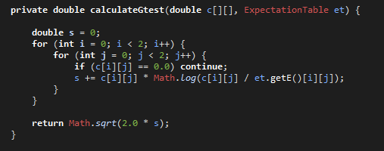
4 - G-Test
Contingency matrix “observations”
https://en.wikipedia.org/wiki/G-test
Expected observations
Result for our example - 0.1848356508203196

Slide 36
How Do We Use The G-Test?
Interpreted as a standard deviation.
Simple threshold. A typical (practical) value is 0.9 for recommendations.
Take the top N highest. We always have a few recommendations.
Group with K-means. Variable thresholding.

Slide 37
G-Test Score Distribution
Surprising relationships:
(0,6) - 0.9207849412295744
(1,2) - 1.3325766911124608
(2,3) - 1.3190718354320086
(2,4) - 1.3325766911124608
(2,7) - 0.9879856047928489
(3,7) - 1.2236855740424832

Slide 38
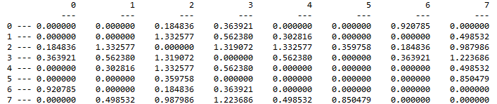
Using Fixed Threshold 0.9
Surprising relationships:
(0,6) - 0.9207849412295744
(1,2) - 1.3325766911124608
(2,3) - 1.3190718354320086
(2,4) - 1.3325766911124608
(2,7) - 0.9879856047928489
(3,7) - 1.2236855740424832
Original
Co-occurance
Matrix
G-Scores

Slide 39
Attaching Recommendations To Search Results
Surprising relationships:
(0,6) - 0.9207849412295744
(1,2) - 1.3325766911124608
(2,3) - 1.3190718354320086
(2,4) - 1.3325766911124608
(2,7) - 0.9879856047928489
(3,7) - 1.2236855740424832
Request for
product 4.
Search
Engine
Information for product 4.
Recommendation for product 2.
Assume a user is requesting item 4 from the search engine. There is a surprising relationship between items 2 and 4. Therefore we recommend item 2 in the results.

Slide 40
Performance Considerations
Need to reduce the size of the co-occurrence matrix.
Remove users who buy too much.
Remove items that are too popular.

Slide 41
Improvement Breakthroughs
Was it fancy mathematics, statistics, algorithms…
No.
Three things
Dithering.
Anti-Flooding.
Multi-modal.

Slide 42
Dithering
Users typically don’t look beyond the first page of results
Don’t scroll.
Don’t go to next pages.
Recommendation engine is evaluated on results it is always returning. Stagnates at initial performance level.
Typical solution
Take the result list and generate a score that is the log of the initial rank.
Add some normally distributed random noise.
Sort according to the new score.

Slide 43
Anti-Flooding
Flooding
Too much of a good thing.
Gives many similar recommendations.
Solution
Reorder the results to make them appear more diverse.
Penalize the rank of any result that appears too similar to higher rated results.

Slide 44
Multi-Modal
Many types of “interactions” – user behaviors
Buying – user-id, buy, item-id.
Viewing – user-id, view, item-id.
Category-preference – user-id, cat-pref, item-id.
Sharing – user-id, share, item-id.
Blogging – user-id, blog, item-id.
Additional modal information appears as additional types of interactions. The A matrix grows horizontally.

Slide 45
Example of Multi-Modal Data
Product
Categories
Products
Products
Products
Products
User-i
Purchases
Views
Shared
Blog
Posts
Category
Interaction Vector
Users
Extended A Matrix

Slide 46
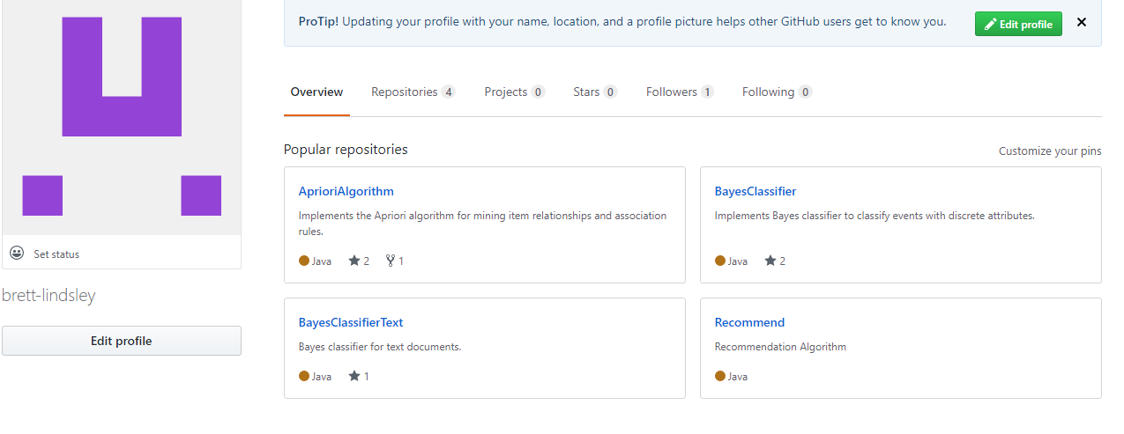
Code
https://github.com/brett-lindsley

